Slide 1


Professional Boundaries The dos the don’ts and the in-betweens 7 November2025
http://www.professionalinsight.co.nz/
Notes:
Rachel

Slide 2

Introductions
Introduction
Outline of today’s course
Concerns during course – raise it with us afterwards
Notes:
Rachel
Kia ora Koutou, lovely to see you all here today. We will start with introductions and then we will get you to introduce yourselves. so
No Tauranga Moana ahau,
Kei Papamoa toku kainga inanianei.
Ko Rachel Kent ahau
I am an enrolled Barrister and Solicitor and have worked in professional regulation for 10 years. I have worked as lawyer at the Medical Council, Social workers R B and Teaching Council. I still do some work for the Medical Council and have been a Convenor on Competence Committees assessing doctor’s competence where concerns have been raised about their practice for 10 years.
Prior to that I was a social worker and worked mainly in health care settings (hospitals, community health centres) and I am a registered social worker. Now I am a private investigator and Director of Professional Insight and have a private investigator licence.
Bindy –
Kia ora koutou katoa
No Waikouaiti ahau
Kei Te Whanganui a tara toku kainga inaianei
Ko Bindy Tatham toku ingoa
No reira, tena koutou katoa
I am a director at Professional Insight which is a venture Rachel and I have set up to provide training and undertake independent investigations. I am a licensed private investigator. Prior to this, I was a lawyer at the Teaching Council and have have also worked as a contract investigator for the Social Workers Registration Board and the Veterinary Council. I practised as a commercial lawyer in the early 2000s, travelled overseas and then took time out of the paid workforce to raise my three daughters here in Wellington. I have two daughters at high school, and one at primary school.
I am pleased to be part of this training today and to facilitate discussion around the area of professional boundaries. For me, recognising the blurry areas and slippery slope is really important to protect students and also you as professionals. Please join in, please share your view and ask questions.
Rachel
We would love to hear all of your introductions Please introduce yourselves and say
Where you are from
What you do as a job
What brings you on the course today
Outline of the morning, with a 15 minute break at half time
On this course we will:
Start with having a look at things at a high level and discuss what terms mean
Discussion about boundary breaches, what form they can take
Impacts of boundary breaches both for the professional and their students
Scenarios and tips how to keep yourself safe
Situations to be aware of – where things might get risky
Social media – scenario, case study and tips on what and what not to do
Your professional responsibilities
What to do if you have concerns
I hope you get something out of this course this morning. It is not designed to be therapeutic. Rather it’s educational and will raise your awareness about professional boundaries so you are more alert to them.
Some things we discuss today can trigger emotions for people. If you are concerned about anything you can either choose to raise it with us at the end or speak to your senior teacher, team leader, manager, mentor, principal etc

Slide 3
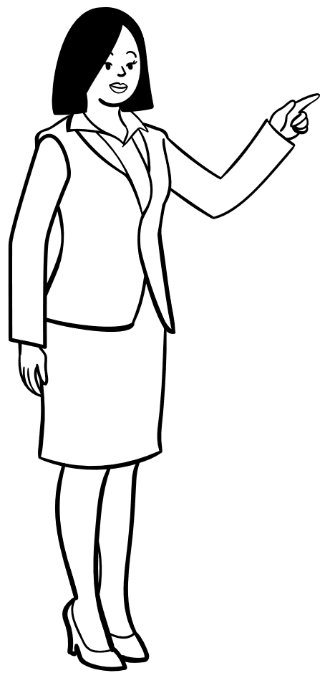
What is a profession?
Notes:
Rachel
A question for you:
What do you think makes a profession different to an occupation or trade?
What are the unique characteristics that make a profession, a profession?
Profession:
specialised body of knowledge, On-going learning -
tertiary qualification,
have a set of values encoded usually in a code of ethics (aspirational) for example: Try to work for social justice
vs
code of conduct which manages behaviour, ‘never discriminate’
Mandatory registration - usually the final stage of when an occupation becomes a profession and sometimes this includes title protection – for example a person in NZ can’t call themselves a social worker now without being registered.
The latest occupational group to become a ‘profession’ is Chinese Medicine (acupuncture, Chinese herbs etc)
Some occupations like to call themselves ‘professionals’ for example HR or librarians, but strictly speaking they are not part of a profession. While they can be professional in their behaviour they have a membership organisation and its not compulsory to be registered.

Slide 4
Professional
Life long learning
Tertiary level qual
Specialised body of knowledge
Mandatory registration
Code of Conduct
Set of values / ethics
Notes:
Rachel
So to sum up:
Profession:
specialised body of knowledge,
tertiary qualification,
have a set of values encoded usually in a code of ethics (aspirational),
code of conduct which manages behaviour,
On-going learning – have to keep up with the research / science / trends
Mandatory registration - usually the final stage of an occupation being a profession is: mandatory registration and sometimes title protection – latest occupational group to become a ‘profession’ is Chinese Medicine (acupuncture, Chinese herbs etc)
Often regulated under a specific piece of legislation –
Q: do you know what law regulates your profession?

Slide 5

Professionalism
What does it mean to be ‘professional?’
What does ‘being unprofessional’ look like?
Notes:
Rachel
What does ‘being professional’ mean to you?
Integrity, behaviour exemplary, polite, respectful, keep up to date with latest research and practice methods, maintain professional boundaries, confidentiality
How you dress and present yourselves in school has an impact on your professionalism – we all know that covid and working from home has changed how people dress and in general people are dressing far more casually in the workplace than a generation ago. What does dressing for school look like for you? What is appropriate/inappropriate? Do you have a dress code policy?
Key characteristic: if you are a member of a profession, you are a professional 24/7
Conduct yourself in line with the Code of Conduct relevant to your profession.
Q Can you name the Code under which your profession is regulated?
Code of Professional Responsibility (teachers)
This is the Code which outlines what behaviour is expected and what behaviour is not acceptable

Slide 6



Professional Regulation
What is professional regulation?
Why are professions regulated?
Notes:
Rachel
Regulated : to protect the public, set standards for the profession, maintain public confidence in the profession
So the government creates a statute for professions to regulate themselves and says: here you go teachers, go forth and regulate your profession.
– so in NZ we say that mostly professions are ‘self-regulated’ – that is all of the main decision making bodies are dominated by members of the profession itself. (eg PCCs, CACs, Councils)
WHO PAYS? What is the financial model?
Why do you think the government and society wants to maintain public confidence in our professions? Why do we need to trust professionals – nurses, teachers, lawyers, social workers?
(Even on a higher level if you think about it sociologically - : society wants people to be able to access the services they provide safely, they want people to be healthy and educated – so they want the kids to go to school and learn and they want people to go to their GP so they don’t end up in hospitals. Otherwise society would deteriorate.

Slide 7
Working with Māori
Tikanga - working effectively with Māori students requires an understanding of tikanga
Whanaungatanga - establishing a relationship of trust by making connections.
Requires the professional to share something about themselves eg about whanau (family), whakapapa (ancestors) or their own personal life
But! do not ‘overshare’.
It is also important that professionals partake in the rituals around food and understand the concepts of tapu and noa.
Notes:
Rachel
I am not going to talk a lot about this as I am not Maori but it is vital, as a NZ professional to understand as much as you can about tikanga.
One of the key concepts is Whanaungatanga
This involves establishing a relationship of trust by making connections.
This can include the professional sharing information about themselves about whanau (family), whakapapa (ancestors) or their own personal life to establish trust and relationship.
Obviously it is important for the professional to understand what is appropriate to share and what would be inappropriate to share about themselves.
Very personal things like your relationship issues would be going to far.
If you have a Maori whanau –establishing relationships with the whanau may be just as important and involving them in decisions about the students schooling will likely be very important –
If you are not sure what is appropriate to share with them, discuss this with your senior teacher or principal
Manaaki involves sharing hospitality or kai (food) to show respect and establish relationships. It is important that professionals partake in rituals around food.

Slide 8

Professional Boundaries
What is a professional boundary?
When is a boundary breached?
Who is responsible for maintaining the boundary?
Notes:
Rachel
What do you think a professional boundary is? How would you define it? Does anyone want to have a go at explaining what a professional boundary is?
How about this definition – which is from the Northern Territory guidelines?
A Professional boundary is:
parameters that describe the limits of a relationship where one person entrusts their welfare and safety to a professional, often in circumstances where a power imbalance might exist.
Q: are you in an equal relationship with your students? What is the power that you hold?
Teacher/student relationship is not equal. It involves trust, care, authority and influence = an inherent power imbalance in all professional relationships
When is a professional boundary breached? - When a professional misuses the power imbalance in the Teacher/ student relationship such that the student’s safety or welfare is compromised -
Who do you think is Responsible for maintaining the professional boundaries? At all times it is the professional’s responsibility to establish and maintain the boundary

Slide 9

Boundary Breaches
Emotional
Financial
Communication
Sexual / Relationship
Grooming – criminal behaviour
Notes:
Bindy
Rachel has introduced the key concepts and definitions around professional boundaries.
There are a number of types of boundary breaches.
These categories are:
Emotional breach – this type of breach could occur by giving preferential treatment to a student.
It could be that you reward or punish students inconsistently as a teacher, or having a ‘favourite’ student and spend more time with them
Q: has there been a time when you have liked or preferred one of your students over another one, and how have you managed that?
manage discussion; It is human nature to like some people more than others, the key is to notice when this happens.
Round up:
A key message that you will hear today is that its crucial that you – as professionals - recognise that while you can be friendly towards students it is not your role to be their friend.
Being a professional means that sometimes you will need to put on your ‘game face’ and not show exactly what is going on for you. Why? It is not about you, it’s about them and while your needs are important, the needs of your students are most important.
It is fantastic that you care, but you cannot over –care and over-share. This is when things get very risky for professionals. You are there to be a TEACHER.
Financial – a breach could arise if a professional gives a student a gift or money OR accepts a gift from a student
Q: Does your school have a policy about accepting gifts?
Communication – this breach includes conduct by a professional that might be considered to be oversharing.
For teachers this might be talking about personal matters or asking students about personal matters that go beyond the teacher-student relationship. Sometimes teachers will have these conversations but these need to be in the appropriate context and sharing about oneself needs to be edited! It is ok to share some small parts of yourself as this is how you build trust and rapport in the relationship – but you need to be aware when you are telling them too much about you – which is generally the more personal things (eg relationship matters, family or friend matters etc)
We will talk later about the pitfalls of social media and how communication in this forum can be particularly risky.
Sexual / Relationship - a breach clearly occurs when a professional engages in an intimate or sexual relationship with a student but there are other behaviours that might also be considered to be a breach – including expressions of romantic feelings or flirtatious behaviour.
Grooming: this is the most serious end of the spectrum and is a criminal offence. Grooming is deliberate, calculated and involves manipulative acts, where the main goal is to get the student to be emotionally dependant to gain trust before starting a sexual relationship.
Case law –
We are now going to look at a 2021 Teacher’s Disciplinary Tribunal case about Mr Fisher where a series of professional boundary breaches, which by themselves may not have resulted in professional discipline, but because there were a number of them, cumulatively, (that is all together) they amounted to serious misconduct.
Mr Fisher was a drama and English teacher. In a year 12 class, he used a sexualised hand gesture mimicking sexual intercourse, he swore (fuck and little bitch), and he discussed topics such as sex and drug use, and he showed students a photo on his phone of a cannabis plant.
He was overly familiar with students and in this case, Mr Fisher’s lawyer argued that “the over familiarity with the students was symptomatic of a person desperate to establish a good atmosphere in the classroom in the hope that it would assist with his teaching.” His lawyer said that it was done without any ulterior motives.
The Tribunal was concerned that there were several incidents where the teacher lacked professional judgement. It was not a “one off”. The Tribunal said the sexualised nature of his behaviour was the biggest concern.
The Tribunal found his conduct undermines trust and confidence and risks impacting students’ emotional wellbeing and learning. The conduct showed a failure to understand basic professional standards and appropriate boundaries between students and teachers. These failings reflected adversely on his fitness to be a teacher and risked bringing the teaching profession into disrepute.
He was ordered to undergo professional development regarding both teacher/student boundaries and have supervision.
This case illustrates how the combination of a number of lesser incidents has combined to be a more serious matter – this is not saying one-offs will be excused, but this teacher exercised poor professional judgment over and over again.
Any questions on this?

Slide 10
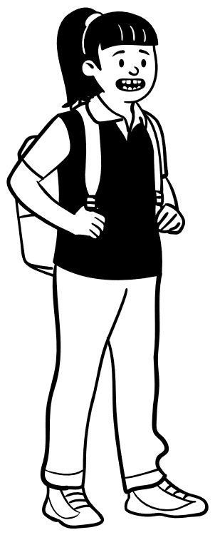
Impacts of a breach on students
Emotional
Social / Home
Work / Achievement
Health
Other people affected too
Notes:
Bindy
We know that boundary breaches can impact students significantly.
Breaches can affect students emotionally. The key thing is that the professional knows more about the student than the student knows about the teacher. It is the professional, therefore, that has all of the power from the very start.
When you have a vulnerable person (and younger people, teenagers are by definition very vulnerable because of their age) a boundary breach has much more of an impact.
It can cause anxiety because they need the teacher’s attention but don’t want to get the teacher in trouble.
Breaches can cause emotional trauma and embarrassment to the student because they can become very dependant on the teacher
And we know that students an also feel very guilty (for getting teacher into trouble) –
Social – Boundary breaches can also students socially. Students can become isolated from friends as they can be seen as being ‘special’ or the ‘teacher’s pet’.
Students may also have difficulties with their friendships because they can’t tell anyone about what is happening in case the professional gets into trouble.
At home relationships can suffer as there is a need to be secretive.
Work – we also know that a student’s work or productivity is affected. For example, if there is a boundary breach, the teacher involved might lose objectivity or professional judgement so aren’t able to give the student fair or objective feedback on their work or give the student a better or worse marks than what they would’ve normally. This affects their future education.
Other people around what is going on can be affected too. It can really affect their trust in the profession: for example other students might start to lack trust in other teachers - so this impacts their learning.
In essence a boundary breach can have severe and long lasting negative effects on students.
example – CAC v Teacher H NZTDT 2021/09)
CAC v Teacher H –
In 2018 Student A was in Year 11 and her and a PE teacher started to become close. It progressed from playing four square together at lunch time and him giving her rides to sports practice.
This PE teacher was very popular with the students and a few had crushes on him.
During field trips in 2020 (when the student was in Yr 13) friends became concerned after observing the teacher and the student A boxing together in the fitness room together before 7 am, seeing student A and the teacher playing cards together, after the water slide having a fight and chasing each other around, and student A was always allocated a place in the front of the line next to the teacher.
Student A’s friends sent a letter for the Principal expressing their concerns about the close relationship between the teacher and their friend.
The Principal met with the teacher with the school’s guidance counsellor. The teacher denied there was any inappropriate relationship going on.
After returning to school in May 2020 after covid lockdown Student A and the teacher were observed eating lunch together on the steps very close to each other. The student and teacher began exchanging facebook messages and arranged to meet before school at an outdoor location away from school to walk and talk. An intimate sexual relationship developed.
Later that year the friends saw some of her text messages between the teacher and the student such as: “ Teacher: I love you for ever teacher” we never expected our love to be this real…” and this was how the relationship was discovered.
The student’s friends were very affected by the relationship between the teacher and their friend. They had liked and trusted the teacher, he’d been very influential in their lives and some felt very jealous that he had chosen this other student over them as his ‘preference’.
While we don’t know if the students wanted to actually have a sexual relationship with him, it was the choosing one student over the others - which added to the hurt.
Some said they didn’t trust teachers now.
The whole community was affected and traumatised and media interest was very high.

Slide 11

Impacts of a breach (on teachers)
Emotional
Social
Work
Home
Colleagues affected too
Notes:
Bindy
There are very similar impacts on teachers as there are on students - although of course because of the power imbalance, arguably less impact on the teacher.
Emotionally – embarrassment, damage to reputation, anxiety because of the need to be secretive, guilt and remorse (sometimes – unless there are narcissist traits there).
Socially – often isolated from friends because of the need to be secretive
Work – the levels of education a teacher provides can drop because they lose their professional judgment and objectivity, productivity can drop because professional is distracted, can face disciplinary action at work, future career prospects suffer, can even face disciplinary action from the regulator – and end up in the Disciplinary Tribunal
Home – relationships at home can suffer (if there is a need to be secretive), if there has been a sexual relationship a teacher can break up from their partner.
Colleagues – they can also be affected – often they are in shock, feel very concerned for the student involved, feel guilty that they didn’t pick up on it or take any action on their hunches, and they might have to be involved in disciplinary processes which is very stressful

Slide 12
Relationships - Personal vs Professional
Personal | Professional
Unpaid | Paid
No power difference – parties are equal | Professional / kaimahi holds all the power
No structure, parties are free to choose how, when, where they interact | Structured and boundaries in place; interactions (generally) take place in professional setting
No training or pre-requisites to form personal relationship | Professional/kaimahi are trained, supported and works within their job description
Relationship based on “friendship” | Relationship may be “friendly” not but “friendship”
Share personal information freely | Maintain professional boundaries and only share information to build necessary rapport
Notes:
Rachel
To summarise the difference between a personal relationship and a professional relationship – here is a nice table – go through table…
Is there anything else you would add here?
Decision making – is objective and based on evidence, vs in a friendship its intuitive or based on gut feelings, subjective and emotional

Slide 13
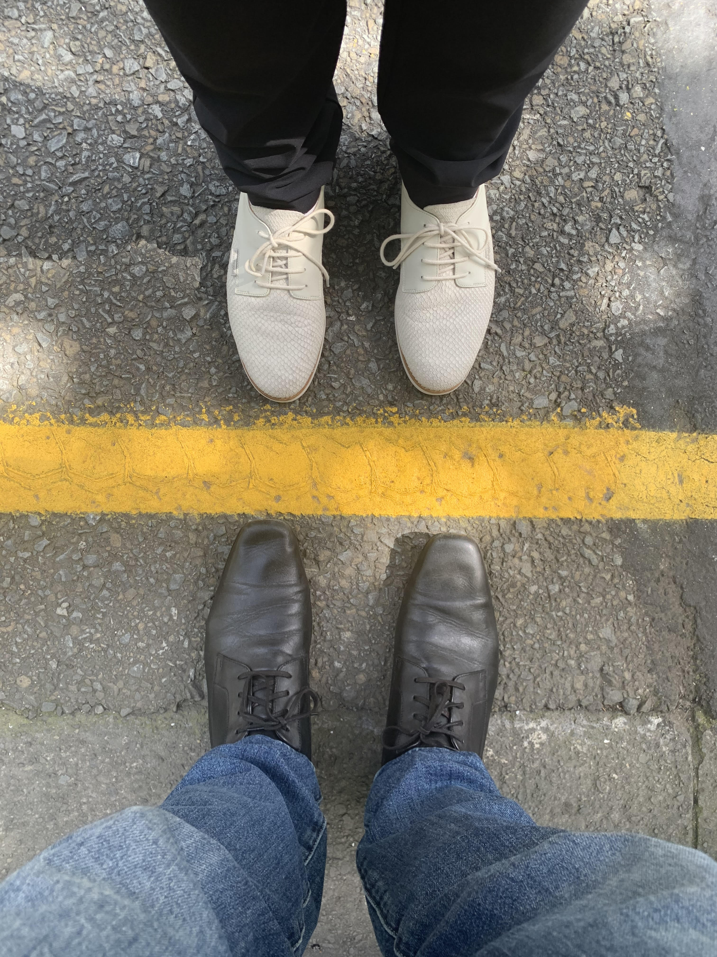
Where is the edge – how do we keep ourselves safe?
Notes:
Rachel
We are going to go through some scenarios and discuss what you might do in each circumstance.

Slide 14

Netball ride home?
Notes:
Bindy - In you groups
Read scenario , discussion what would you do?
You coach a Year 9 netball team and the team has just finished an after school game at a neighbouring school. You have been talking with a colleague and go to leave.
It’s 6pm and you see that one of your players has not been picked up. After talking with the student, you find that she has left her cell phone back at school.
What do you do? Outline possible next steps.
From discussion need to have covered,
-keep teacher and student safe,
-contact with student’s parents
- Ask student or parents if there is anyone else who can pick student up
- contact with teacher’s senior ie DP or Principal.
If no other option but to take student home, text and get parent consent, text when arrived and delivered student

Slide 15

Helping a distressed student
Notes:
Rachel
Read scenario. Student message received late in the evening
You have just received an email from one of your Year 10 students. It is 9 pm and the message says that
“My life at home is crap and I am really unhappy and scared and I don’t know what to do, I have taken Mums car.”
What do you do?
(pass it on, say to the student ‘I have to tell someone’)
Is it ok to help a student in distress? When is it not ok? When do you refer to someone else? What do you do if the student says “I don’t want you to tell anyone” or “you are the only adult I can talk to”
Need to have covered you as teacher do not keep this information to yourself pass it on, the student could be in danger, you are not a counsellor there are others who can check on safety,
Does your school have any policies around responding to students after hours? What’s the general practice? Are your students allowed to contact you after hours?

Slide 16
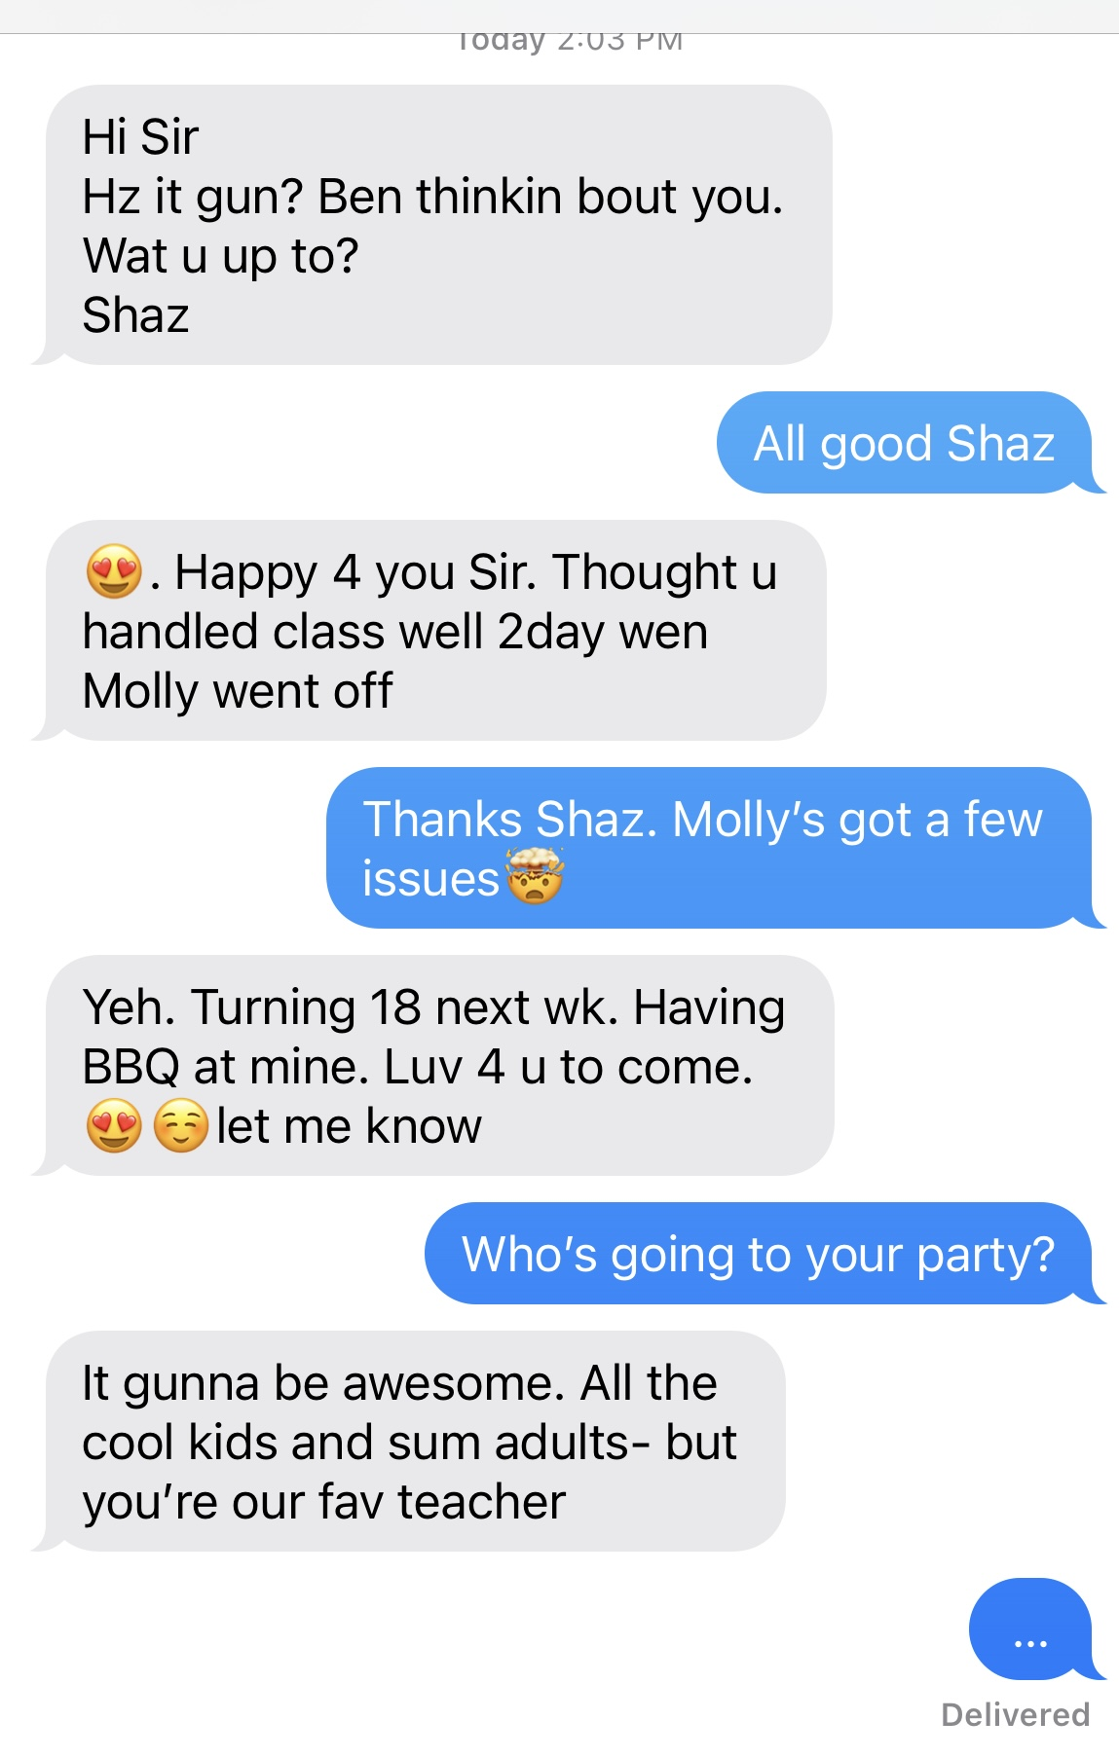
18th birthday party invite
Notes:
Bindy
Have a read of this text exchange.
Then:
What are the issues here?
Where have they crossed the boundaries?
Do you think the teacher should accept the invite?
What about self-reflection? What was the relationship between teacher and student before this message?

Slide 17
When are boundary breaches more likely?
What do you think are the factors that contribute to boundaries being breached?
When do you think a teacher is more likely to breach a boundary?
Think about: teacher situation, teacher characteristics, students characteristics, school environment….

Slide 18
What we know…
Teacher is at more risk of breaching professional boundaries if:
becomes a confidant / friend
is new to the teaching profession
is emotionally immature
is vulnerable themselves
lives and works rurally
Social media
Teachers that work alone
Environment factors – at place of work
Student factors? CAC v Neal NZTDT 2021/10
Notes:
Rachel
Things start to get dangerous when the teacher becomes a confidant, friend or counsellor to the student/s / consumer
We know that people who are new to the profession can be at more risk of breaching boundaries, - they :
may be few years older than the students
still developing a professional identity – so trying to decipher what the difference is between personality, personal persona and how to be a professional and what that means
Teacher is emotionally immature (moral compass not quite developed) – and this is not confined to young teachers!
The teacher is vulnerable / needy themselves /having a difficult time in their personal lives - it tends to make them more susceptible to student adoration
Teacher lives and works rurally and everyone ‘socialises’ together. Rural teachers may have dual or multiple roles – they can be outdoor ed teacher and basketball coach, go on the school camps and also be the fire volunteer and the sailing teacher.
(discuss if you want to)
Social media - this is an obvious area and we will go into more depth soon
Professionals are more at risk of breaching boundaries if they work alone or are physically isolated at work–
Q: if you find yourself working alone with a student, one on one - , what are the things you do to keep yourself safe? (not work alone, keep door open / tell a colleague where you are/ ensure the wider team –
Ensure your Principal or senior manager (AP/DP) knows where you are and what you are doing there / move to the library / move to where there is another adult.
Q: What about changing rooms? Do you go in?
School / environment factors: we know that schools that lack of policies about how to engage with students or use of social media put their professionals at more risk of crossing boundaries.
Or there is a lack of support for new teachers – and the management culture is such that teachers feel unsafe to share concerns,
Unfortunately, some schools aren’t 100% committed to protecting children, but in fact, value the school reputation more and want to protect that.
Student factors?
Q: Do you think there are certain students who are more at risk of their teacher crossing a boundary with them?
Not all students / consumers are mature or level-headed. Teenagers or young adults are discovering their sexuality and can be flirtatious and provocative.
Some may have mental health issues and are very needy and vulnerable and cross all boundaries as they don’t really know about them – but who is responsible for the boundary??? This is when your responsibility to maintain the boundary is even greater. The professional at all times is responsible.
I’ll tell you now about a case that illustrates that regardless of how the student behaves, its still the professionals responsibility to maintain the boundary
Mr Neal was teacher at a Wgtn High school – and went to the Yr 13 leavers dinner. He was in his early 70s.
An 18year old complained after the dinner that Mr Neal had touched and pinched her bottom while saying to her “nice bum”
Mr Neal admitted he did it but said that the student was being ‘sexy and lovely’ and ‘threw herself at him by putting her arm around him and pulling him in’. This was no defence for Mr Neal.
Q: What do you do if a student is being ‘sexy’ and ‘lovely’ and flirtatious?
remove yourself, distance yourself, you are responsible for maintaining the boundary and distancing yourself from any inappropriate situation – teenagers are discovering their sexuality and are full of hormones and teachers need to be fully aware and wary of this!

Slide 19
A slippery slope?
Behaviour – good intentions
Behaviour - incrementally progresses to an emotional dependency
Professional believes - honestly assisting the student / consumer
Is ‘over-familiar’
….professional discipline
CAC v Teacher V NZTDT 2020/22
Notes:
Rachel
Just to sum up where we have got to so far. Sometimes teachers have good intentions and there is no intention to exploit a student – they want to assist the student
Sometimes a teacher’s Behaviour can incrementally progress to create an emotional dependency
But the Teacher believes they are honestly assisting the student
The teacher Is ‘over-familiar’ with them to create the ‘connection’, get them ‘engaged’, too enthusiastic about them
they cross the line from being ‘friendly and supportive’ vs ‘being friends with’
Student then tells parents or someone ….professional discipline
Here is an example of a case where a teacher makes a clumsy attempt to engage with a student but crossed a boundary but had no bad intention
CAC v Teacher V NZTDT 2020/22
A male teacher had been a teacher for 32 years at a boys school. His career had been exemplary.
He then went to a girls school to do a years teaching just before he retired.
He taught 16 year old girls for the first time in his career. One girl was starting to lose interest in the subject and he wanted to engage her.
On a few occasions he said things like: “I love you. I love everything about you”, “after Tuesday you are going to be all mine”, and “I miss you make sure you come back”.
He said he was just trying to help.
The student stopped taking his class and stopped that subject – and she was really good at that subject.
The teacher had made no attempt to extend the relationship beyond that of teacher/student and he didn’t hide his actions – it was just a clumsy and naive attempt to get the student engaged.
Penalty: ordered to get a mentor if he was to get a teaching job and show any employer the decision. 50% of the Costs – can be significant ($1000s)
It was a very sad end to a long career of teaching
Break now for 15 minutes, get a cup of tea, see you back at ??

Slide 20

Social Media
Accepted that it’s essential, but carries inherent risk
Clear distinction between professional and the private
Notes:
Bindy
It is accepted that it’s essential for teachers to be able to use certain online platforms – but this area demands a higher level of professionalism and awareness.
There needs to be a clear distinction between the professional and the private – any conversation with students needs to be solely focused on educational matters.
The problem with social media platforms (including texting) is that they encourage a type of communication that isn’t within the bounds of professional behaviour – its an incredibly risky place to communicate.
Q: Why do you think communicating electronically increases the risk? Over to you…
Check these things come up:
Casual forum
informal language is the norm
encourages use of emojis which can have various meanings
Opportunity for misinterpretation – how often have you misinterpreted what another has written?
Speed is also a risk – the speed of the communication is often an issue, people expect instant replies. Be very careful when you are using a hand held device to communicate with your students or consumers
The number of text messages that can happen in a minute is huge – and when we have seen it in print, in a bundle of evidence, it can amount of pages of a story that looks pretty bad and reflects very poorly on the professional, as you will see in some real case examples shortly
Everything online is permanent, regardless of how it is used - including snapchat

Slide 21

Social media transcripts in print
Online ‘chats’ different to in-person conversations
Case example: CAC v Coad NZTDT 2020/18
Notes:
Bindy
When you see transcripts of conversations that have taken place on social media in black and white its often quite a stark reminder that your language and behaviour on ‘informal chats’ are very different to those you would have in person. You can also see the length of the transcripts – whereas if you look at your phone, you only ever see snippets or the latest few messages.
Coad
Mr Coad was a teacher at an AK high school and left there to go and work at a high school in in Southland. After he left Ak and just before he started working - in fact as he travelled the south island towards his new job - he engaged with some of his former Year 12 students in a group conversation on Instagram.
[Show transcript in appendix of DT decision] – we are just gong to bring up the electronic version that is included in the published decision and give you all some time to read through – we will discuss it next

Slide 22
Extract from instagram chat
Mr Coad: [photo of cats] these are too cute
Student: pussy
Mr Coad: T hat’s my cats
Student: u mean ur pussies. They could use a haircut aye
Student: No one like a hairy pussy
Mr Coad: My cats. Cats don’t cause hassle […]
Student: r u saying pussies do […]
Mr Coad: Pussies are a pita.
Mr Coad: Jamie has joined. Sup, Jamie!! I’m laughing at the fact I’m having an insta group chat with yr 12s
Student: keep laughing
Mr Coad: I sometimes think im not mature enough to be a teacher
Student: why’s that Edward
Mr Coad: See current situation
Notes:
Bindy
When you see transcripts of conversations that have taken place on social media in black and white its often quite a stark reminder that your language and behaviour on ‘informal chats’ are very different to those you would have in person. You can also see the length of the transcripts – whereas if you look at your phone, you only ever see snippets or the latest few messages.
After everyone has read:
The Tribunal stated that his conduct was “extremely silly” and not only did this occur outside of school hours for a non-educative purpose, it was clear the students (who were of an impressionable age) were wanting to impress Mr Coad. The Tribunal said that the tone of the conversation was unforgiveable in terms of his duty to maintain a professional relationship with his students and that it was incumbent on Dr Coad to resist all attempts to engage him in the group chat and, certainly, to shut the chat and his involvement down when the topics of conversation turned lewd and unbecoming of a teacher to his student. He was censured and ordered to do a course on Prof Boundaries. The Tribunal did not cancel his registration because the Instagram chat was “part of a group conversation and did not involve him forming an inappropriate relationship with one student”.
Mr Coad was significantly remorseful and he resigned and said he wanted to leave teaching. Although he applied for name suppression he wasn’t granted it. This case was widely reported in the media and it was reported to have had a significant impact on his wife and school aged children.

Slide 23
Scenario – Social Media
Sally Smith – 27 years old, new teacher, teaches science to Yr 11 and 12
Luke (Yr 12) sends her a FB friend request – which she declines and explains she can’t be FB friends
Luke then messages her some science questions, which she answers
Next evening, Luke sends her more questions and Ms S answers them
Luke then tells Ms S that she is cool, and compares her to other teachers using the ‘stupid face’ emoji
Ms S does not discourage him and says that Mr Riley (the DP) is out of touch and uncool and uses an ‘old man’ emoji and then a ‘laughing face’ emoji
Luke then asks Ms S what she is doing at the weekend and they start chatting about common interests including what their favourite movie is.
Notes:
Bindy
Ask a participant to read out this scenario
Discuss this in your groups.
What are the issues here? What are the concerns? Consequences?
Did not actively discourage the FB messenger contact,
her derisive comments about the DP were unprofessional, disrespectful, undermine DPs authority,
could be interpreted as grooming behaviour,
She could lose the respect and trust of Luke, other students, other teachers, Parents could get involved and complain thinking that there is a relationship going on.
‘Top of the slippery slope’
DON’T engage with students on social media through your personal page fullstop.

Slide 24

Top Tips for safe Social Media use
Use school approved ways to communicate online
If you need to text or ‘group chat’ – add another colleague, particularly if student is vulnerable
Do not ‘friend’ or ‘follow’ students
Check privacy settings
Slow communication down
Notes:
Bindy
Use work place approved platforms for interactions with students.
Q: do your school have specific online platforms for interacting with students?
- If you are using a social media ‘group chat’ consider adding another teacher into the group, or at least another adult.
Do not ‘friend’ students, do not ‘follow’ students – do not accept requests. Politely decline and say that you have a policy not to friend students. Allowing access to your personal information allows them to know more about you than you would ever share in person – they are not your friends.
Consider anything you put on social media or online at ANY time is permanent and can be found by students and screenshot.
If you have photos of yourself drunk on Courtney Place on your private page, remove it now.
If a student is persistent, tell your Principal or Senior teacher and get advice on how to deal with it. You cannot control if someone finds your number and messages you, but if or how you respond, is in your control and your role as a professional must be first and foremost in your mind – you are a registered professional 24/7, not just when you are at work.
Take the time to Check privacy settings - be aware that Facebook and other social media platforms will sometimes change their privacy settings. Consider not having your full name up on FB or having a non-identifying profile picture
Choose your online ‘friends’ wisely - however
Q: is it ok for a professional to disparage their employer or the Ministry of
Education on a private page?
All solid ‘evidence’ for the Teaching Council
Slow comms down, think before you post/send anything online

Slide 25

Your responsibilities
Code of Professional Responsibility – 4 commitments
Promoting the well-being of learners and protecting them from harm– 2.1
Engaging in ethical and professional relationships with learners that respect professional boundaries -2.2
Duty to report possible misconduct to maintain reputation of profession - 1.5
Notes:
Rachel - TEACHERS
The Code of Professional Responsibility requires that teachers are committed to the teaching profession and its reputation, to learners, to families and whanau and to society.
I am not going to go into detail here but I would strongly recommend that you read the Code and the Examples in practice booklets.
The specific parts of the Code related professional boundaries are:
2.2 I will work in the best interests of learners by:
2.1 promoting the well being of learners and protecting them from harm
And
2.2 engaging in ethical and professional relationships with learners that respect professional boundaries.
Under 1.5 – which covers your commitment to the teaching profession it states:
I will maintain public trust and confidence in the teaching profession by:
1.5 Contributing to a professional culture that supports and upholds this Code:
Example: taking action to stop harmful, unethical or unlawful actions of a colleague where there behaviour may be in breach of this Code – so you have a professional duty to report possible misconduct to maintain the professions reputation.
Note: Seen as a breach of the Code if a teacher imposes or threatens to impose negative repercussions on someone who has spoken out about a teacher’s unethical, harmful or unlawful behaviour – so its important to note, you won’t get into trouble.

Slide 26
Are you at risk of crossing a boundary?
We are all human….
But how can you manage yourself as a professional?
How can we prevent a boundary being crossed? What are your thought processes?
Notes:
Rachel
What are some key things you could ask yourself ? What do you think you can do to prevent yourself crossing a professional boundary?
How do you know you might be at risk of crossing a boundary?
Self awareness
Awareness of your relationships with students
Do you want to ‘save’ them?
Do you need to be seen as highly important in their lives?
Are you Depressed or anxious at the moment?
Do you need to be liked or adored

Slide 27
Ask yourself:
Would I change my behaviour if I was being watched?
Am I sharing information because I need to be liked?
Would I judge my conduct negatively if I saw it in another professional?
How would I explain my actions to Principal, my Senior, or my partner?
Notes:
Rachel
In order to recognise if you might be either breaching the boundary or are on the edge – ask yourself:
Would I change my behaviour if a colleague or a family member was present?
Am I interacting differently with a particular student differently than with other students? Am I showing favouritism?
Am I doing something for them that they could do themselves, that is, fostering a dependency? Or am I being harsher on them than others?
Am I frequently thinking of that student when I am away from work?
Is my dress, my language, my availability or my demeanour different when I am with a particular student ?
Am I sharing information with or helping this student because I need to be liked or be seen as ‘special’ or ‘helpful’?
Am I a person who needs adoration? Am I particularly vulnerable in my personal life at the moment? Anxious or depressed?
Ask yourself – do I really need to respond to that text message right now? At all?
Is it possible that my behaviour could adversely affect the well-being of a student?
Whose needs are being met if I do this particular activity?
Would I judge another teacher negatively if I saw them doing what I am doing?
How would I explain my actions to my seniors – my Principal, the BoT, my partner, the Teaching Council?

Slide 28
What to do if you have concerns
Be aware - of self and others
Tolerance of the behaviour by others is not relevant
Tell a colleague, deputy principal, your mentor or the Principal
What might stop you telling?
What if your senior does nothing or downplays it?
Notes:
Bindy
Rachel has talked about questions to ask yourself about your behaviour but what do you do if you have concerns about how a colleague is behaving?
For example, if you think a colleague is showing too much attention to a student and is too close to them?
Tolerance of the behaviour by other people is not relevant. If others think that what your colleague is doing is acceptable but you think they are crossing a professional boundary, you need to act. It is your professional duty.
You may choose to talk to your colleague first and seek clarification about what is happening or you may prefer to sound out a mentor because these professional conversations can be difficult.
Always Tell a senior (principal,) or colleague if you are concerned about anything – about yourself or someone else – get advice, ask for help.
Q: If you were concerned about a colleagues behaviour, what would stop you from telling your senior? (fear, embarrassment, being seen as a nark, hurting the student involved, hurting or getting your colleague into trouble)
Q: What do you do if your manager does nothing or downplays it? Email them to confirm your conversation and ask for reply, if still going on, go up the chain – DP, Principal, BOT, or… if its very serious the professional regulator such as the Teaching Council
If you remain concerned, keep on it as it is your professional duty to protect students from harm.

Slide 29

Key messages?
What is one thing that you have learnt today?
Notes:
Rachel
Thank you so much for coming today.
We are all aware of how damaging professional boundary breaches can be for the parties involved - the student, the teacher, friends of everyone involved, families of everyone involved, colleagues and managers.
Take a couple of moments to think about what you have learnt today?
Would anyone like to share one thing they have learnt today?
Can you please fill out the evaluation form that we will send to you. Once you have completed that we will send you a certificate of attendance.

